Slide 1


AWS SOLUTIONS ARCHITECT ASSOCIATE
Module 6:
Monitoring to Enhance Security

Slide 2
Module Overview
AWS CloudTrail
Amazon Virtual Private Cloud (Amazon VPC) Flow Logs
AWS Config
Amazon Inspector
AWS Certificate Manager
AWS Web Application Firewall

Slide 3

Lesson 01: AWS CloudTrail

Slide 4
AWS CloudTrail
Always on
Event history
Multi-region configuration
Log file integrity validation
Log file encryption
Data events
Management events

Slide 5
AWS CloudTrail
CloudTrail Insights
Integrations
  AWS Lambda
  Amazon CloudWatch Logs
  Amazon CloudWatch Events

Slide 6
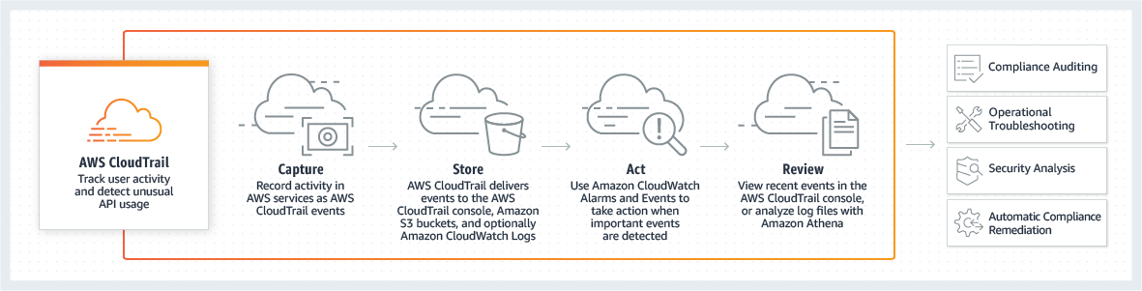
AWS CloudTrail

Slide 7
Lesson 02: Amazon Virtual Private Cloud (Amazon VPC) Flow Logs

Slide 8
Amazon Virtual Private Cloud (Amazon VPC) Flow Logs
Flow logs basics
  Elastic Load Balancing
  Amazon RDS
  Amazon ElastiCache
  Amazon Redshift
  Amazon WorkSpaces
  NAT gateways
  Transit gateways

Slide 9
Amazon Virtual Private Cloud (Amazon VPC) Flow Logs
Flow log records
  Aggregation interval
  Default format
  Custom format
  Available fields
Flow log record examples
Flow log limitations
Flow logs pricing

Slide 10
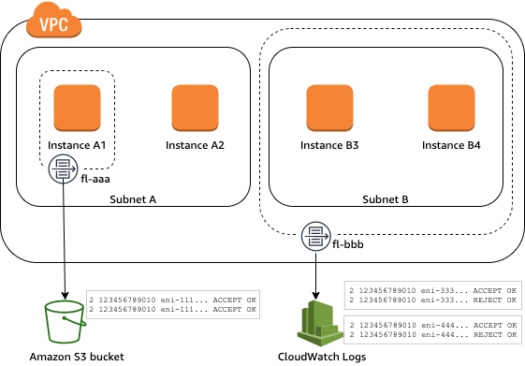
Amazon Virtual Private Cloud (Amazon VPC) Flow Logs

Slide 11
Lesson 03: AWS Config

Slide 12
AWS Config
Configuration history of AWS resources
Configuration history of software
Resource relationships tracking
Configurable and customizable rules
Conformance packs
Multi-account, multi-region data aggregation
Extensibility

Slide 13
AWS Config
Configuration snapshots
Cloud governance dashboard
Partner solutions
Integrations
  Connect with ITSM / ITOM Software
  AWS CloudTrail
  AWS Systems Manager
  Amazon EC2 Dedicated Host
  Application Load Balancers

Slide 14
Lesson 04: Amazon Inspector

Slide 15
Amazon Inspector
Identify application security issues
Integrate security into devops
Increase development agility
Leverage aws security expertise
Streamline security compliance
Enforce security standards

Slide 16
Lesson 05: AWS Certificate Manager

Slide 17
AWS Certificate Manager
AWS Certificate Manager (ACM)
  Elastic Load Balancing
  Amazon CloudFront
  Amazon API Gateway
ACM Private CA

Slide 18
AWS Certificate Manager
ACM Certificate Characteristics
  Domain Validation (DV)
  Validity Period
  Managed Renewal and Deployment
  Browser and Application Trust
  Multiple Domain Names
  Wildcard Names
  Algorithms
    2048-bit RSA
    4096-bit RSA

Slide 19
Lesson 06: AWS Web Application Firewall

Slide 20
AWS Web Application Firewall
Web traffic filtering
Full feature API
Real-time visibility
Integration with AWS Firewall Manager

Slide 21
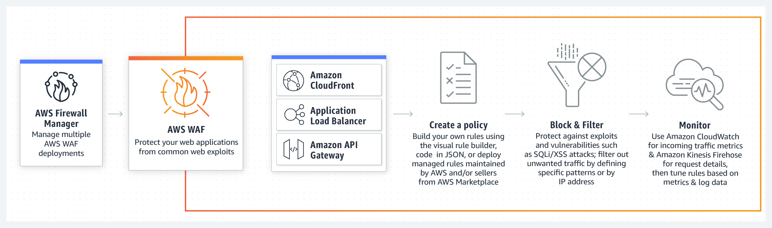
AWS Web Application Firewall

Slide 22
Lab Module 6

